Slide 2
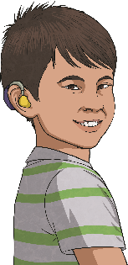
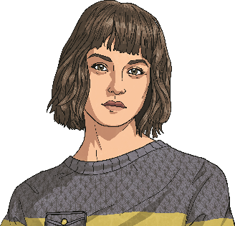
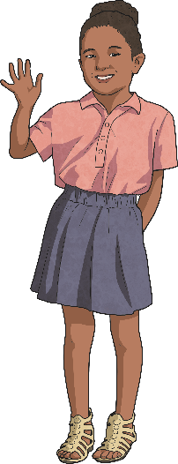
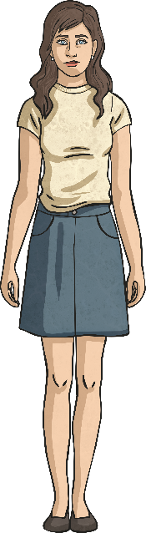
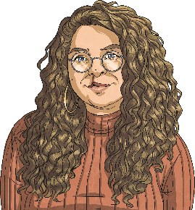
Vocabulary Review
Match the sentences to the pictures.
She has short hair.
He’s young.
She’s tall.
She’s short.
She has long hair.

Slide 3
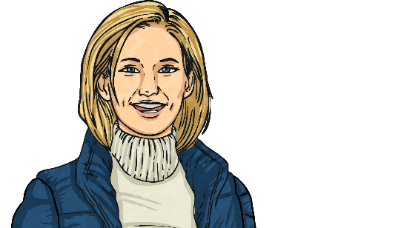
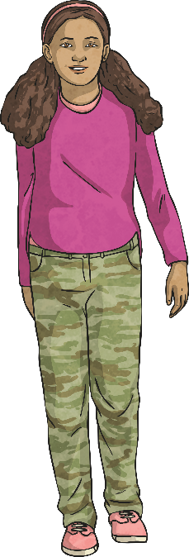
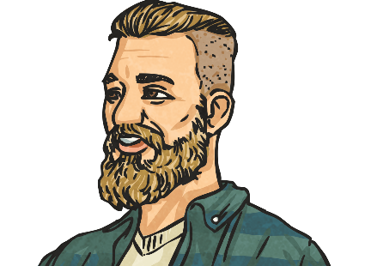
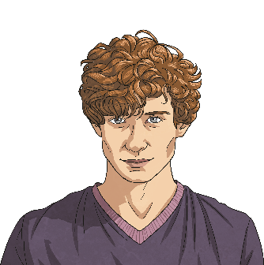
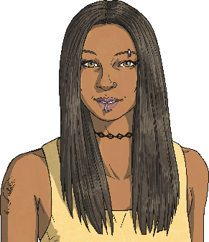
Vocabulary Review
Match the sentences to the pictures.
He has curly hair.
She has blonde hair.
She is slim.
He has a beard.
She has straight hair.

Slide 4
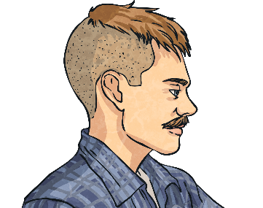
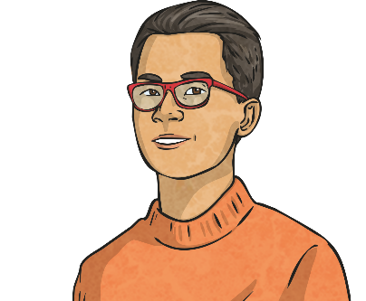
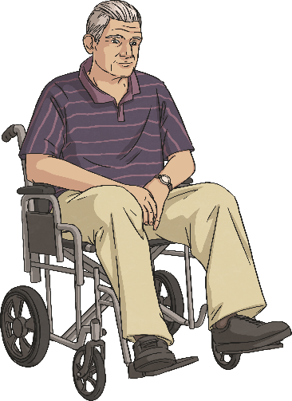
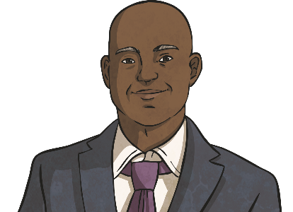
Vocabulary Review
Match the sentences to the pictures.
He’s elderly.
He has a moustache.
He’s bald.
He has dark hair.

Slide 5

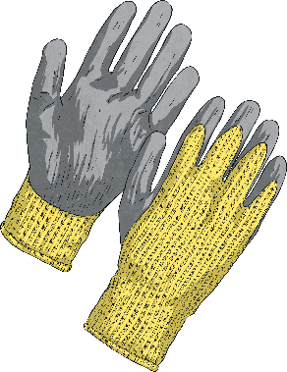
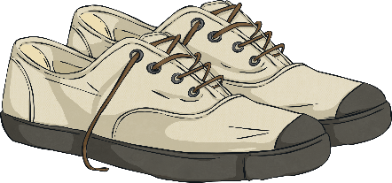
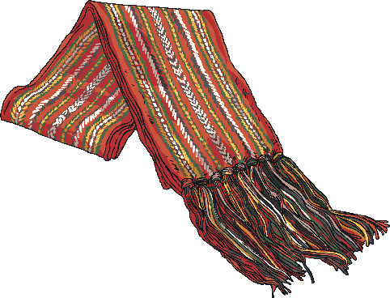
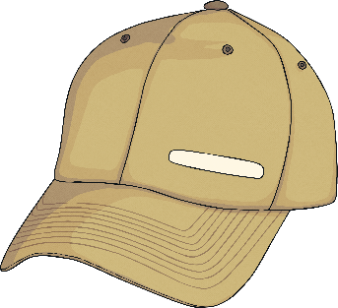
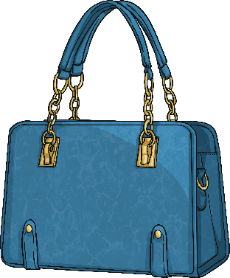
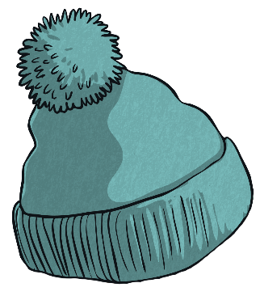
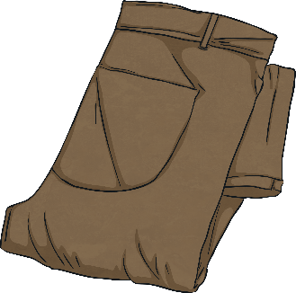
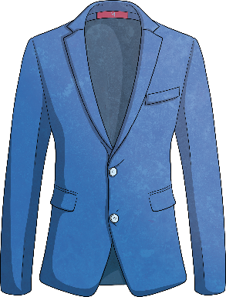
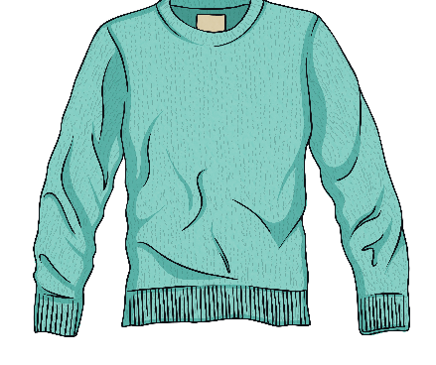
Vocabulary Review
Do you know these words?
glasses
scarf
gloves
shoes
cap
trousers
handbag
hat
jacket
jumper

Slide 6
Teacher:
Set your timer.
You have 13 minutes to escape the tower.

Slide 7
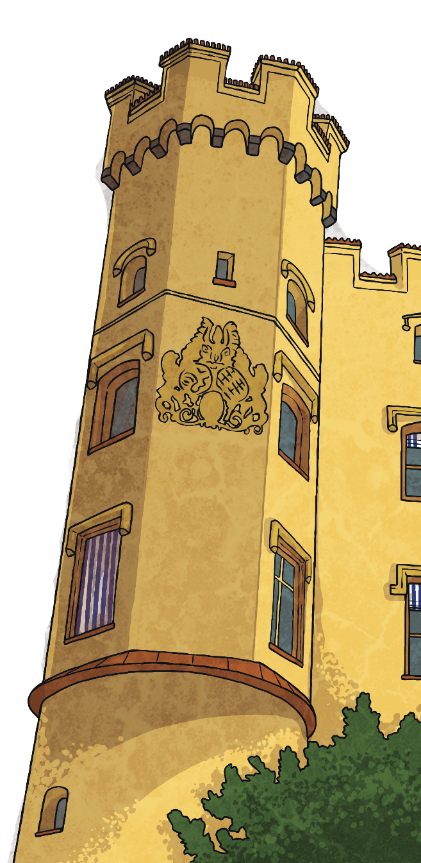
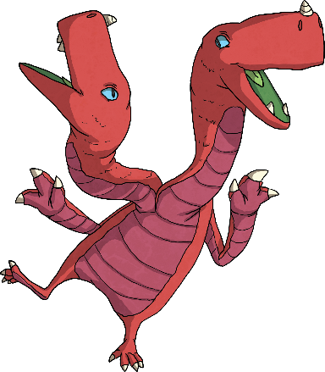
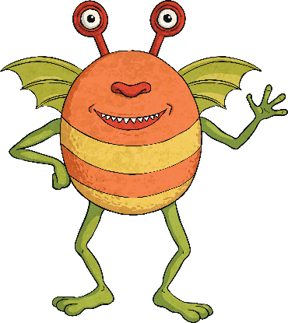
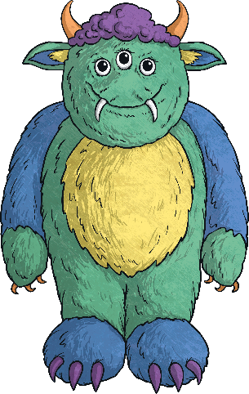
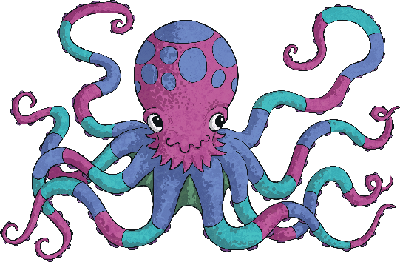
Oh no! You’re at the top of a tall, tall tower...
To escape, you’ll need to get past four monsters.
Each monster has a different task.
The answer to each task will give you one of the four digits of the code you need to escape the tower.
Complete all the tasks
correctly to get the right code!
1.
2.
4.
3.

Slide 8


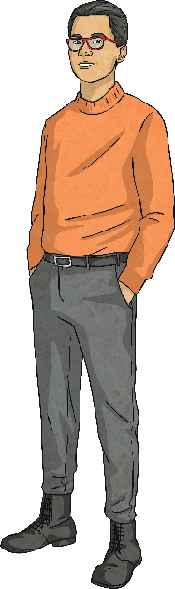
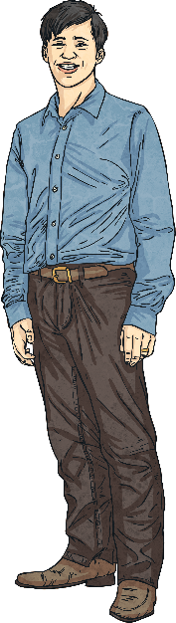
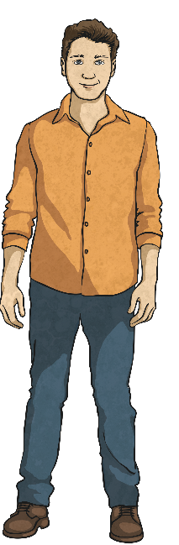
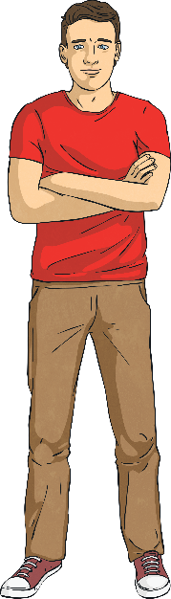
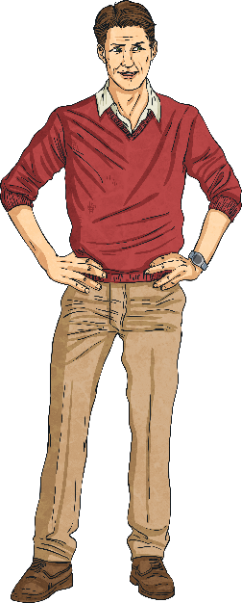
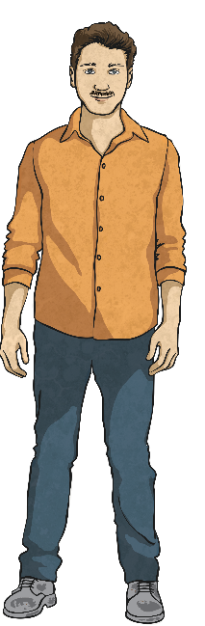
The First Monster
Who am I describing? The number of the correct
picture is the first digit of the code.
He's tall and has short brown hair. He's wearing blue jeans, a shirt and brown shoes. He doesn't have a moustache or a beard.
1
2
3
4
5
Reveal Answer
3
6

Slide 9

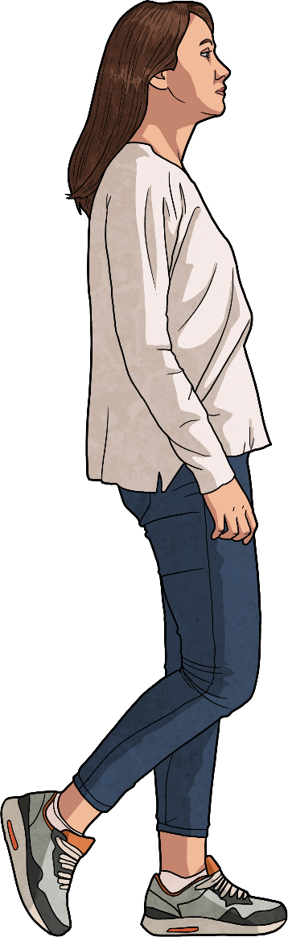
The Second Monster
Reveal Answer
Follow the arrows and answer the questions about the picture to get the second digit of the code.
Does the woman have long hair?
YES
NO
Is she wearing a jacket?
Does she have glasses on?
YES
NO
YES
NO
Is she wearing a scarf?
What colour are her trousers?
What colour is her hair?
Is she carrying a handbag?
YES
NO
BLACK
BLUE
BLONDE
BROWN
YES
NO
1
2
3
4
5
6
7
8

Slide 10
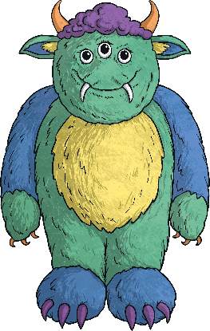
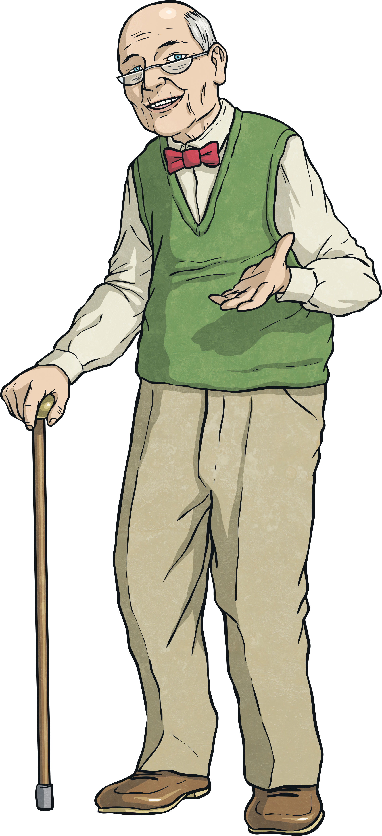
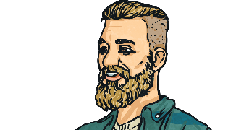

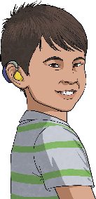
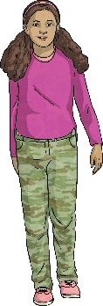
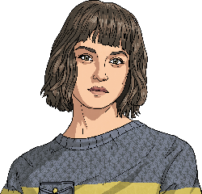


The Third Monster
What are these words?
Look at the pictures and say the words. The letters in blue spell out the secret word. The number next to it is the third digit of the code.
b
e
a
r
d
l
o
n
g
h
a
i
r
y
o
u
n
g
s
l
i
m
s
h
o
r
t
h
a
i
r
g
l
a
s
s
e
s
m
o
u
s
t
a
c
h
e
Which word do the blue letters spell?
1
2
1
English
encrypt
3
4
5
English
easiest
engines
equally

Slide 11
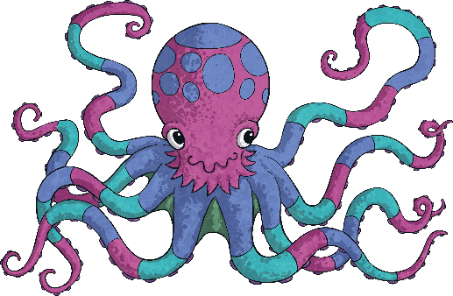
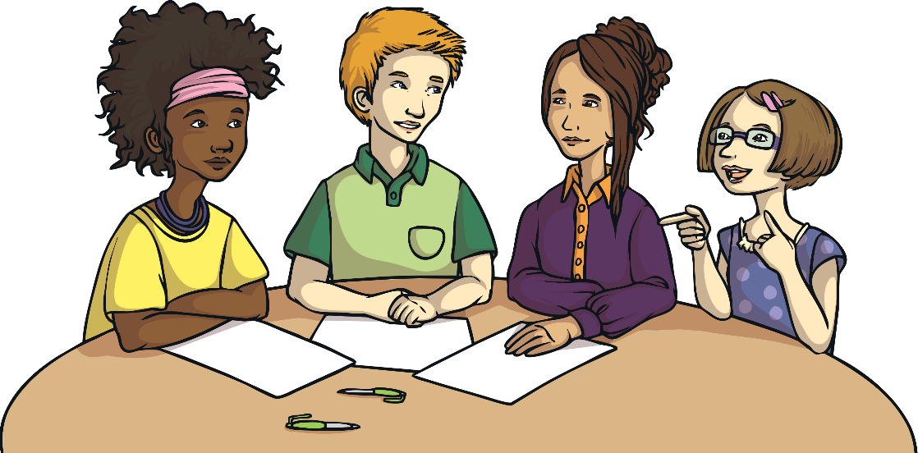
The Fourth Monster
Read the sentences and say the numbers. The correct combination gives you the third digit of the code.
1
The number of people in the picture who wear glasses.
?
1
The number of people in the picture who have curly hair.
?
Reveal Answer
2
The number of people in the picture who have short hair.
?
1
The number of people in the picture who have blonde hair.
?
1
2
3
4
1224
1121
3313
1432

Slide 12




Use the four digits you got from completing the monsters' tasks.
Did you get the right code to escape the tower?
2.
3.
1.
4.
4
1
3
2
Reveal Answer

Slide 13
You’ve escaped the tower!

