Slide 1


English
Spelling
Year One
English | Year 3 | Spelling | Suffixes -ing, -ed, -er, -est and -y

Slide 3
A root word is the basic form of a word before any parts are changed or added on. Click on the root words below to see how they can be changed by adding different suffixes (endings)...
copy
copier
marry
marrying
baby
babies
happy
happiest
cry
cries

Slide 4
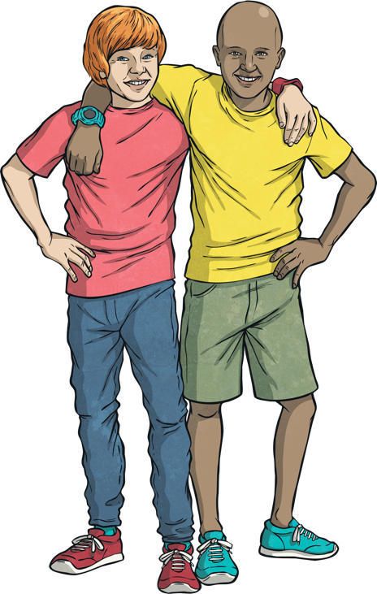
Click on each sentence to see a root word that ends in -e with a consonant before it.
Friends are nice to each other.
When my dad cleans his motorbike, he rubs it to get it to shine.
The ghost train makes my sister scream, but it doesn’t scare me!
At the weekends, we put on our walking boots and go for a long hike.

Slide 5
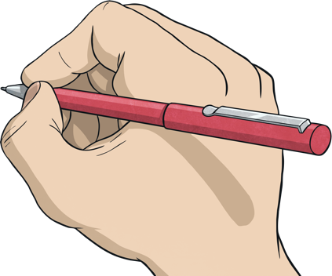
We can change words by removing the -e before adding the suffixes -ed, -ing, -er, -est, -y. Change the root word hike…
Click on the boxes to change the root word
hiked
hik
?
?
ed
+
?
=
ed
Remove the –e before adding

Slide 6

We can change words by removing the -e before adding the suffixes -ed, -ing, -er, -est, -y. Change the root word hike…
Click on the boxes to change the root word
hiking
hik
?
?
ing
+
?
=
ing
Remove the –e before adding

Slide 7
We can change words by removing the -e before adding the suffixes -ed, -ing, -er, -est, -y. Change the root word nice…
Click on the boxes to change the root word
nic
er
nicer
?
+
?
=
?
er
Remove the –e before adding

Slide 8
We can change words by removing the -e before adding the suffixes -ed, -ing, -er, -est, -y. Change the root word nice…
Click on the boxes to change the root word
?
?
nic
nicest
?
+
est
=
est
Remove the –e before adding

Slide 9
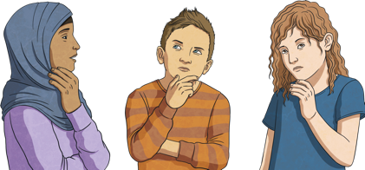

What is the root word here?
Click on the box to find the root word
?
shining
shiny
shine
=
or
Remove the –e before adding
ing
y
or

Slide 10

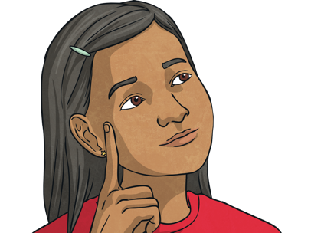
This rule does not work for every word ending with 'e'. There are a few exceptions.
For example
see
seeing
free
freeing
be
being

Slide 11
Split into two teams. Take it in turns to click on three cards. If you find a root word and its two matching words with the -ing, -ed, -er, -est or -y endings, score a point for your team. Whichever team has found the most tricky trios at the end of the game is the winner.
hike
?
shining
?
scaring
?
hiker
?
nice
?
hiked
?
shiny
?
nicest
?
shine
?
nicer
?
scare
?
scary
?
(Click the cards again to turn them back over if the words are not all found in that turn.)

Slide 12
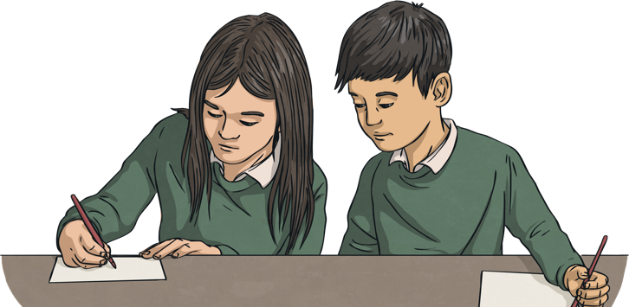
Here are your new spelling words to practise.
hiking
hiked
hiker
nicer
nicest
shiny
being
shining
scary
scaring
Work hard to learn them!

