Slide 1
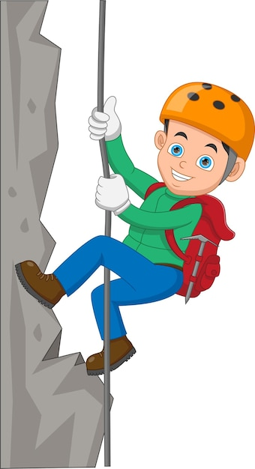

climb
mb
Start Timer
Start Timer
Next
Use Timer
Show Answer

Slide 2
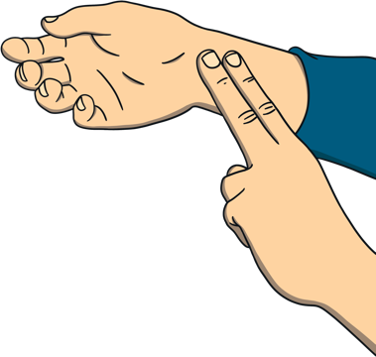
wr
wrist
Start Timer
Start Timer
Next
Use Timer
Show Answer

Slide 3
kn
knit
Start Timer
Start Timer
Next
Use Timer
Show Answer

Slide 4

wr
wrull
Use Timer
Show Answer
Start Timer
Start Timer
Next

Slide 5
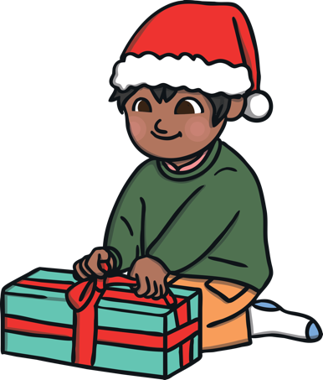
wr
wrap
Start Timer
Start Timer
Next
Use Timer
Show Answer

Slide 6
gn
gnish
Use Timer
Show Answer
Start Timer
Start Timer
Next

Slide 7
mb
gomb
Start Timer
Start Timer
Next
Use Timer
Show Answer

Slide 8
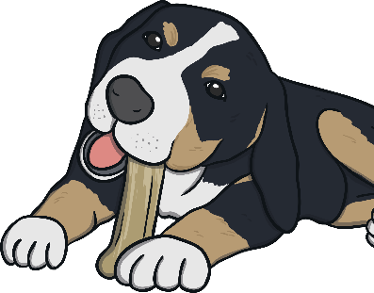
gn
gnaw
Use Timer
Show Answer
Start Timer
Start Timer
Next

Slide 9
kn
knooth
Start Timer
Start Timer
Next
Use Timer
Show Answer

Slide 10

wr
wrab
Use Timer
Show Answer
Start Timer
Start Timer
Next

Slide 11

wr
write
Start Timer
Start Timer
Next
Use Timer
Show Answer

Slide 12
kn
knock
Start Timer
Start Timer
Next
Use Timer
Show Answer

Slide 13
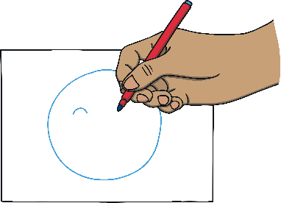
design
gn
Use Timer
Show Answer
Start Timer
Start Timer
Next

Slide 14
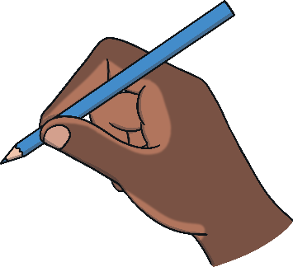
signed
signed
Start Timer
Start Timer
Next
Use Timer
Show Answer

Slide 15
kneff
kneff
Start Timer
Start Timer
Next
Use Timer
Show Answer

