Slide 1
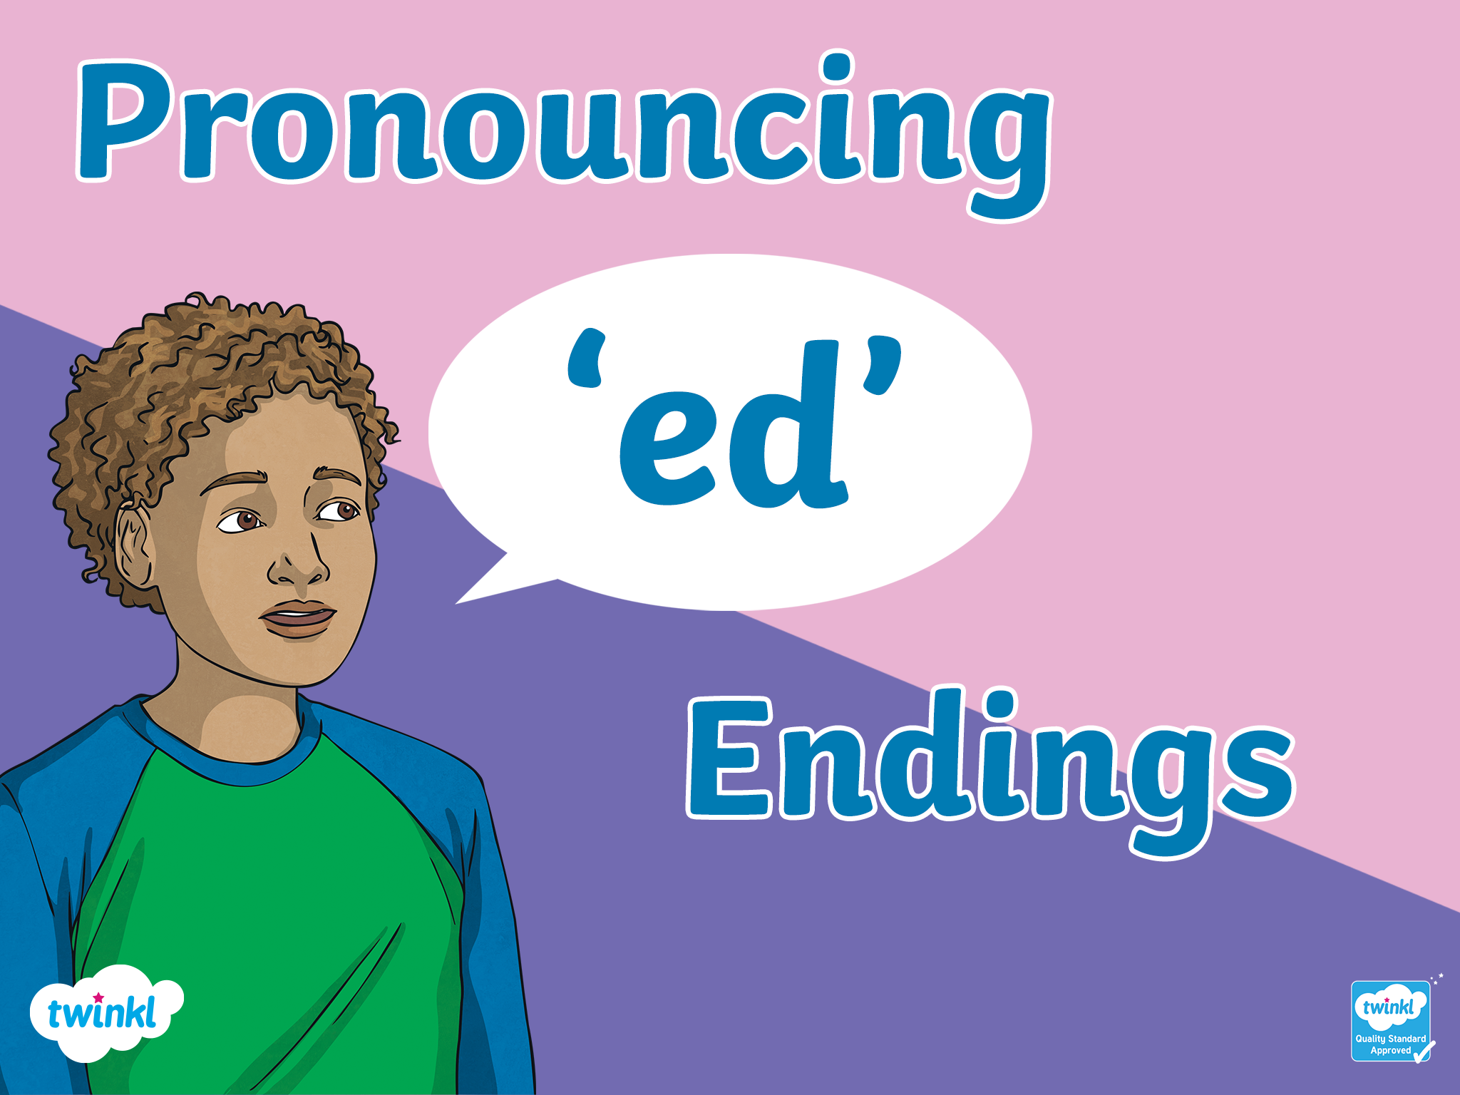


Slide 2
What do all these verbs have in common?
arrive
thank
end
talk
walk
study
try
wait
use
start
edit
travel
want

Slide 3
All these verbs are regular verbs. That means that to make the past simple, we use an ‘ed’ ending.
Present
Past
walk
walked
want
wanted
try
tried

Slide 4
‘Ed’ can make different sounds.
Sometimes it sounds like ‘id’
So how do we know when to use these different sounds?
Sometimes it sounds like ‘d’
Sometimes it sounds like ‘t’

Slide 5

All these ‘ed’ endings make the ‘id’ sound. Can you guess the rule?
started
wanted
ended
pointed
edited
needed
x
Look at the last letter of each verb.
Listen and practise
Hint!
If the verb ends in a ‘t’ or a ‘d’, the ‘ed’ ending makes a ‘id’ sound. This adds one extra syllable. Now practice the words!
Show answer

Slide 6
Now put your hand on your voice box.
Try saying these sounds:
Listen and practise
mmmm
eeee
vvvv
zzz
d
Can you feel your voice box vibrate!
Yes!
Try saying these sounds:
Listen and practise
k
p
t
s
Can you feel your voice box vibrate!
No!

Slide 7
All these ‘ed’ endings make the ‘t’ sound. Can you guess the rule?
talked
walked
helped
matched
missed
placed
Keep your hand on your voice box, and think the last sound in each verb.
Listen and practise
If the verb ends in a sound that doesn’t vibrate your voice box, we use the ‘t’ ending. This adds no extra syllables.
Show answer

Slide 8
All these ‘ed’ endings make the ‘d’ sound. Can you guess the rule?
Keep your hand on your voice box, and think the last sound in each verb.
used
studied
travelled
tried
played
listened
filmed
Listen and practise
If the verb ends in a sound that vibrates your voice box, we use the ‘d’ ending.
This adds no extra syllables.
Show answer

Slide 9
Can you put these verbs in the right category?
‘ID’ sound | ‘D’ sound | ‘T’ sound
start | used | talked
ended | studied | walked
edited | travelled | helped
wanted | tried | matched
pointed | played | missed
needed | listened | placed
 | filmed
adopted
liked
helped
laughed
moved
saved
decided
filmed

Slide 10
Check your answers!
‘ID’ sound | ‘T’ sound | ‘D’ sound
start | talked | used
ended | walked | studied
edited | helped | travelled
wanted | matched | tried
pointed | missed | played
needed | placed | listened
adopted | laughed | filmed
decided | helped | saved
 | liked | moved

Slide 11
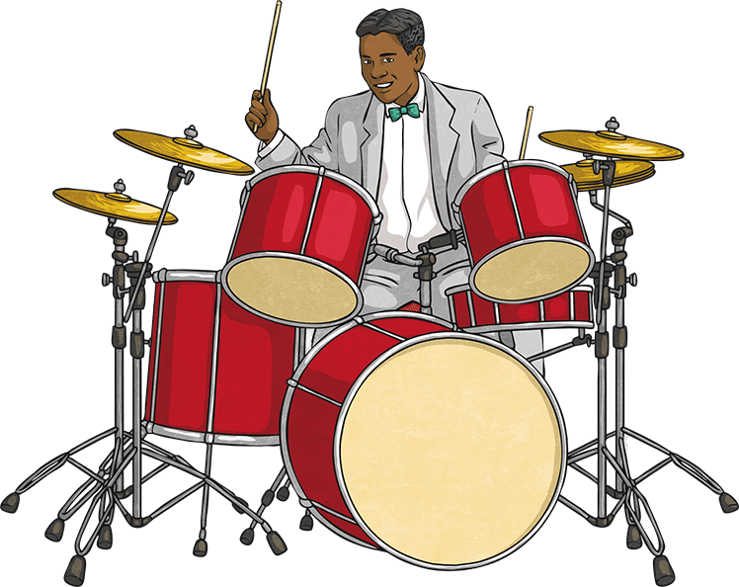
Do you find the ‘t’ ending difficult?
Many learners do.
Imagine you’re playing the drums!
Listen and practise
Practice these sounds as if you were paying imaginary drums.
‘K’
and
‘T’
Then practice them together:
‘K’ - ‘T’ as fast as you can.
And then finally practice saying them at the end of a word: Wal-k-t

Slide 12
